Slide 1
Introduction to Programming
Lecture 6

Slide 2
Agenda
Revision on Reference variables and Pointers
Revision on functions Part1
Functions Part2 (Passing by reference)

Slide 3
Revision on Reference Variables and Pointers

Slide 4
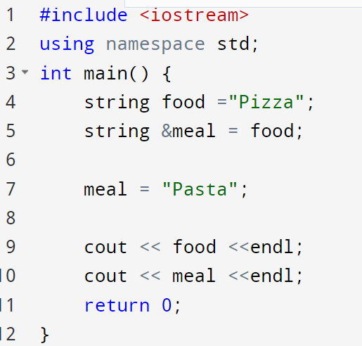



Reference Variable
Memory
Pasta
food
meal

Slide 5
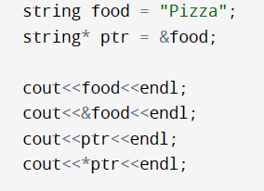
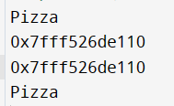




A Pointer
A pointer is a variable that stores the memory address as its value.
A pointer variable points to a data type (e.g. int or string) and is created with the * operator. The address of the variable you are working with is assigned to the pointer.

Slide 6
Revision on functions Part1

Slide 7
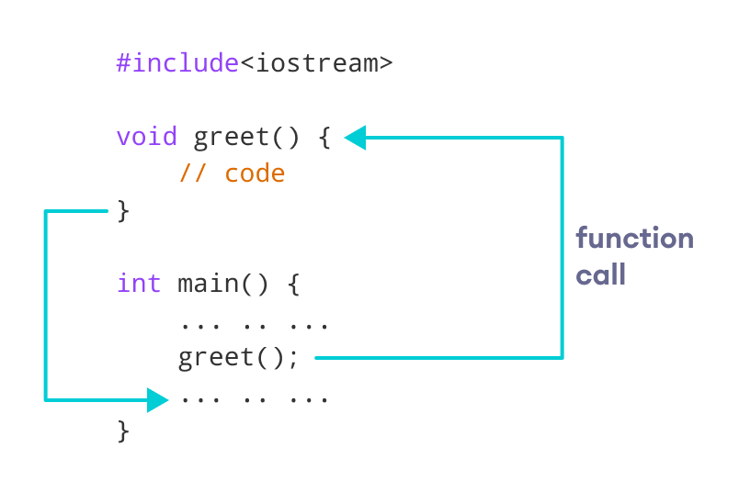

Functions

Slide 8
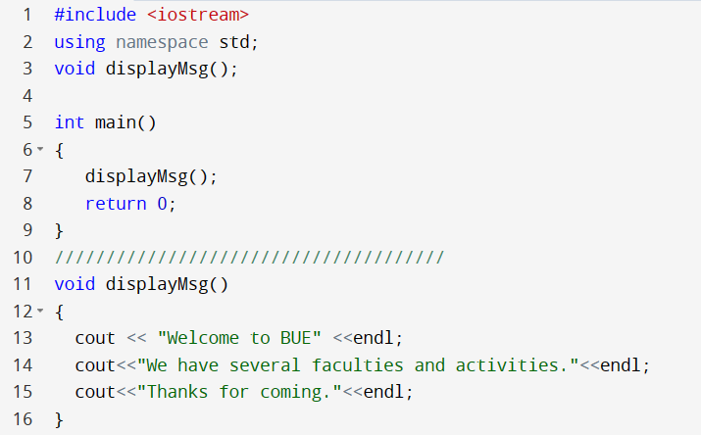
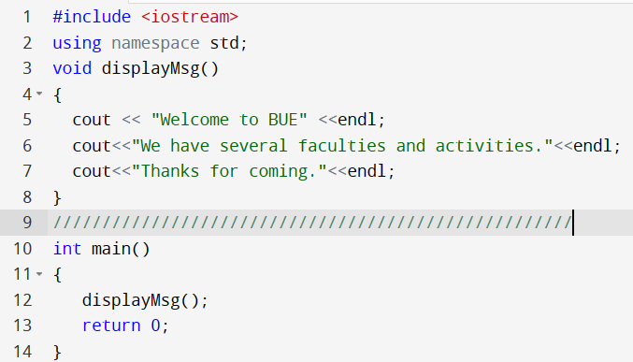




Function declaration
Function code after main
Function declaration
Or the whole function before main

Slide 9


Parameters and Return type
Main sends to function data through
Parameters
main
function
Caller
function send to main data through
Return type
Callee

Slide 10
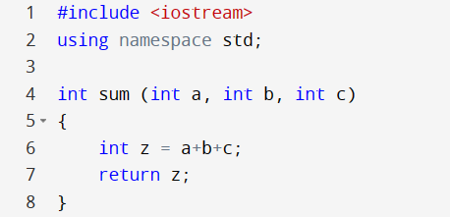
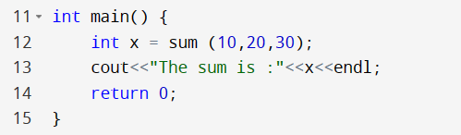



User-defined Functions

Slide 11
Passing parameters
Passing parameters
By Value
By Reference

Slide 12
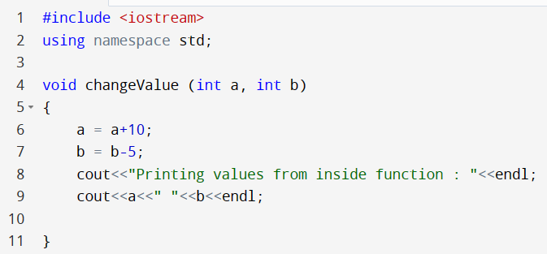
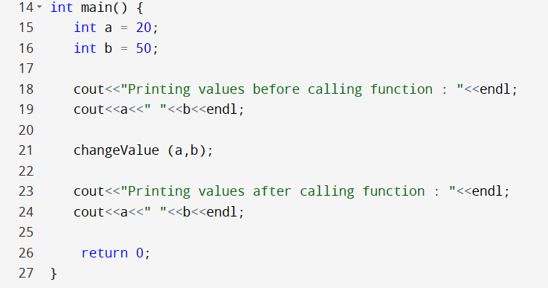

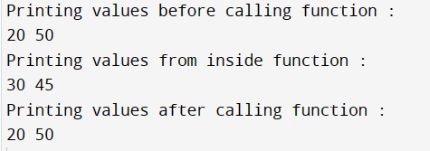
Passing parameters by value
Pass by Value (also known as pass-by-copy)
a
b
a
b
Passing parameters by coping the value
20
50
20
50
a
b
30
45

Slide 13
Functions Part 2 (Passing by Reference)

Slide 14
Passing parameters
Passing parameters
By Value
By Reference

Slide 15
Functions Part 2 → Passing by Reference for primitive data types and Strings

Slide 16
Passing by reference
The call-by-reference method of passing arguments to a function copies the reference of an argument into the formal parameter.
Inside the function, the reference is used to access the actual argument used in the call.
This means that changes made to the parameter affect the passed argument.

Slide 17
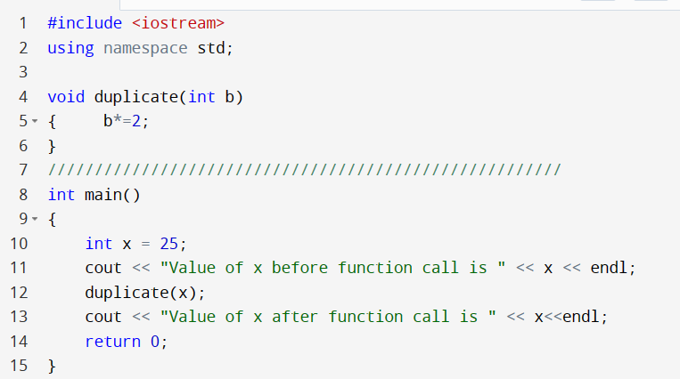

Example 1: Passing parameters by Value
Memory
25
x
b
25
50

Slide 18
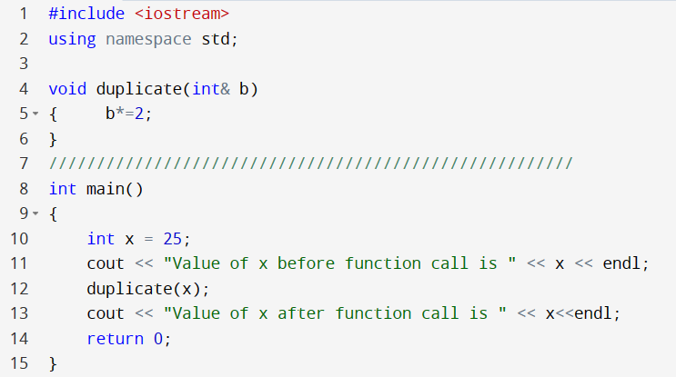


Example 1: Passing parameters by Reference
Memory
25
x
50
b

Slide 19
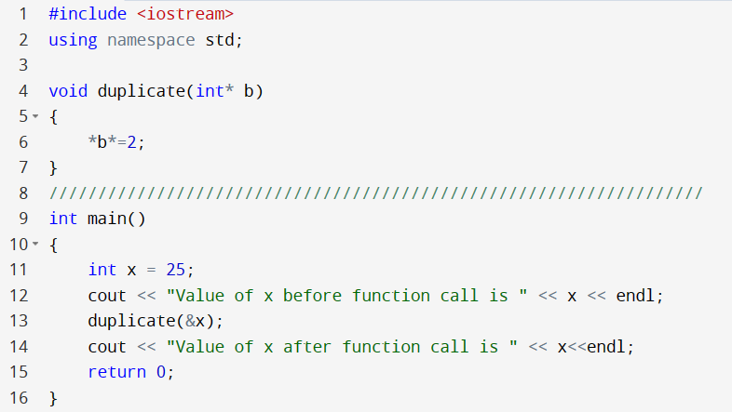



Example 1: Passing parameters by Reference
Memory
25
x
50
b

Slide 20
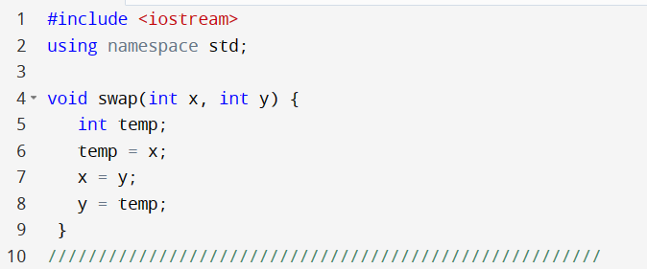
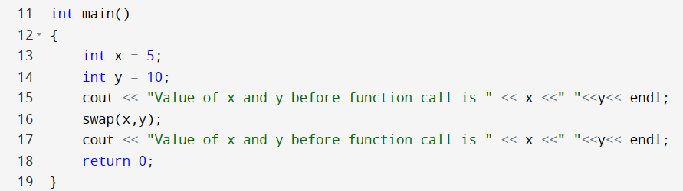


Example 2: Swap by Passing parameters by Value
x
y
5
10
x
y
10
5
x
y
5
10
Passing parameters by coping the value

Slide 21
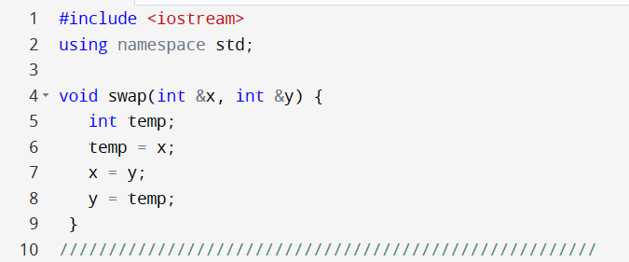


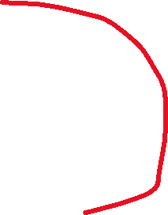

Example 2: Swap by Passing parameters by Reference
x
y
5
10
x
y
They are pointing to the same memory locations
10
5
x
y
5
10

Slide 22
Functions Part 2 → Passing by Reference for arrays

Slide 23
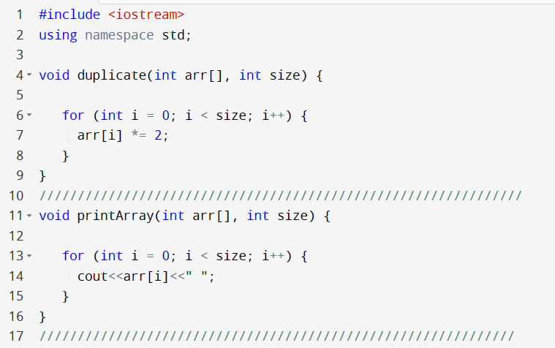
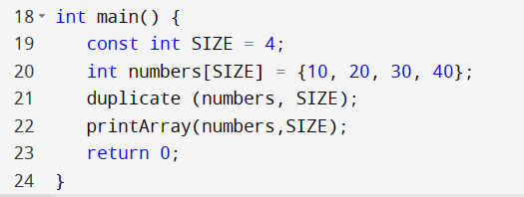



Example 2: Arrays always passed by Reference

Slide 24
Arrays are always passed by reference
An array is passed into a function as a pointer to the first element of the array.
You can use array notation (e.g., int[]) or pointer notation (e.g., int*) in the function declaration.
The compiler always treats it as a pointer.
The following declarations are equivalent:
void duplicate (int arr[], int size);
void duplicate(int arr[4], int size);
Void duplicate (int *arr, int size);

Slide 25
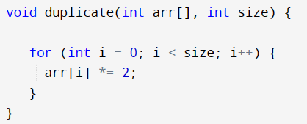
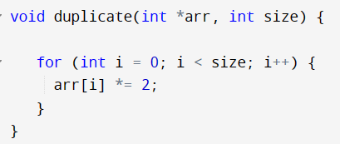



Different declarations, the same effect
Same effect

Slide 26
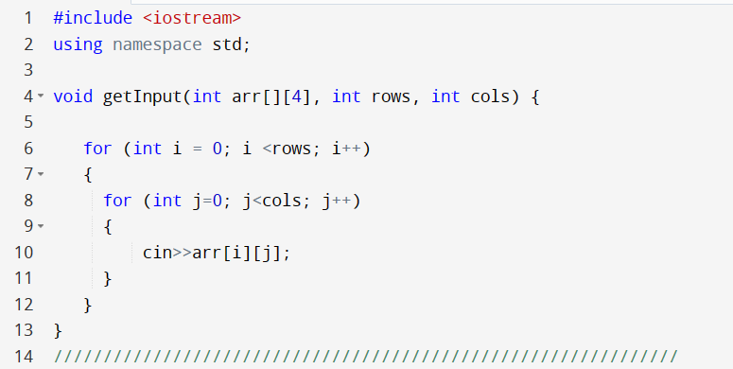
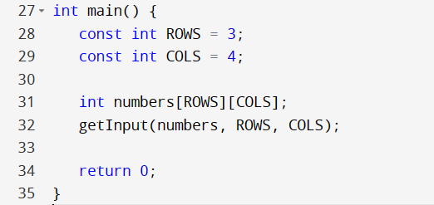
Two dimensional array
While passing the 2D array, you need to at least Specify the size of columns of 2D array
Local variables
Seen only within main

Slide 27
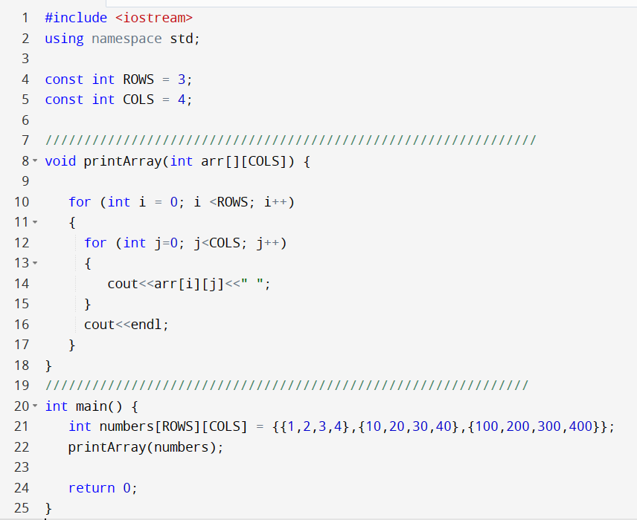




Visibility of global variables versus local variables
Global Variables
(main and all functions could see them)

Slide 28
Functions Part 2 → Returning an array

Slide 29
Returning an array in C++
C++ does not allow to return an entire array as an argument to a function.
However, you can return a pointer to an array by specifying the array's name without an index.
Returning a single-dimension array from a function, is by declaring a function returning a pointer
Inside the function, the returned array should be declared as static to avoid warnings or unwanted behavior.
Notes:
The static keyword can be used to declare variables and functions at global scope

Slide 30
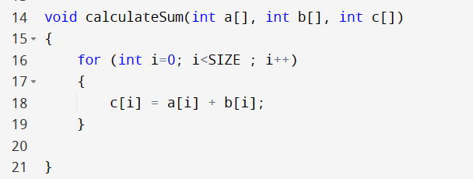

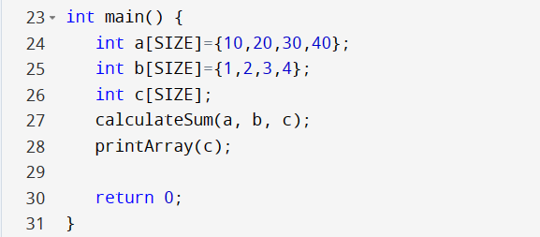
Example 3: Returning an array in C++
Write a function that sums up the elements of two arrays in a third array.
SIZE is declared as a global variable

Slide 31
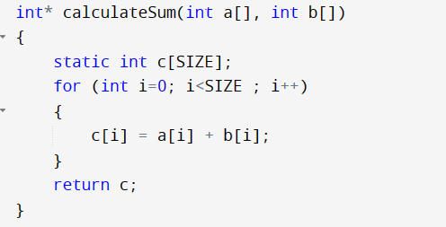
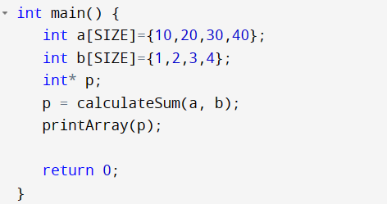



Example 3: Returning an array in C++
You are returning a pointer to an array which is local to the function. If you declare it as static, it means the lifetime of the array extends until the end of the program.

Slide 32
Functions Part 2 → More Examples

Slide 33
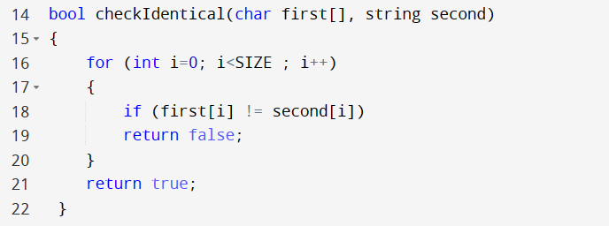
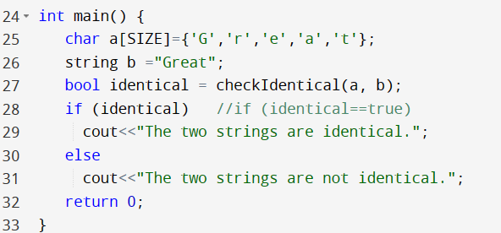


Example 4
Write a function that takes a string and an array of characters to check whether they are equal or not. The function returns a boolean value.
A string is an array of characters

Slide 34
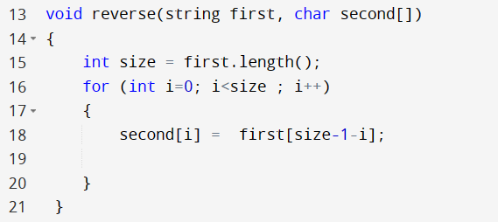
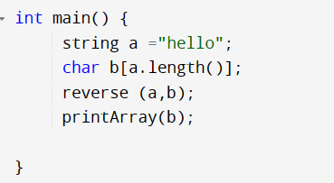
Example 5
Write a function that takes a string and returns an array of characters representing the reverse of the string.
size-1-0
When i=0
h | e | l | l | o
size-1-1
When i=1
h | e | l | l | o

Slide 35
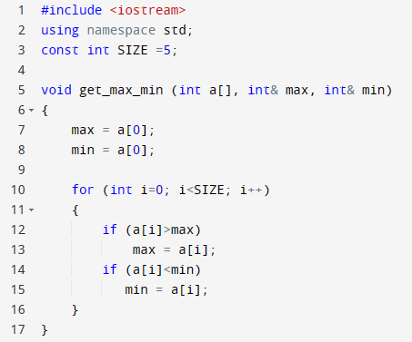
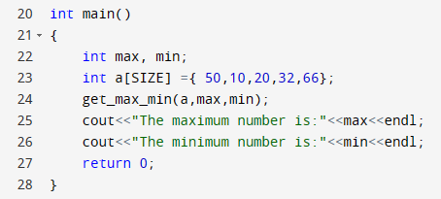


Example 6
Write a function that returns the maximum and minimum number form an array of integers.
Useful when we want to return
more than one value

Slide 36

Thank You

